Slide 1
Virtual reality

Slide 2
Group Members
Matt Kalafut – History, Evolution
Jordon Kopp – Science and Technology, Psychology
Vince Smeraldo – Art, Education
Josh Kopp – Business
Derek Finch – Future

Slide 3
Introduction
Virtual reality – an advanced form of human-computer interfaces that will immerse the user in a computer-generated world that allows user interaction

Slide 4
Thesis
Virtual reality is an emergent technology that is bringing forth advancement to many fields such as psychology, education, medicine, and military in the form of simulations, providing realistic virtual environments for the user to experience.

Slide 5
History and Evolution

Slide 6
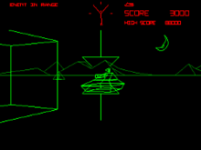
Early History & Tech
Dates back to the 1920s
Started as vehicle simulation
Extremely primitive
Basic Shapes
International Arcade Museum, n.d.

Slide 7
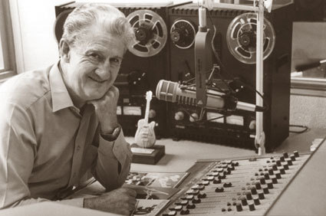
Who Invented It?
Controversy over actual creator
Evolved from several various technologies
Many contributors
Officially Morton Heilig
Widely accepted as official “inventor”
TimeRime, n.d.

Slide 8
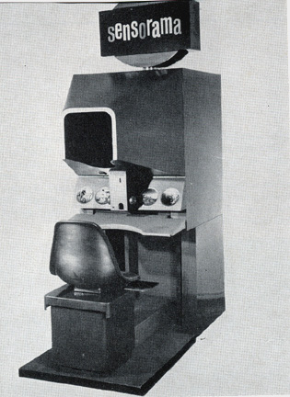
Sensorama
Idea originated in 1950s
1962 – Sensorama prototype invented
Large machine
TV screens, fans, other machinery
Displayed 5 short films
Engaged sight, sound, smell, touch
Not widely adopted
Very unsuccessful
Lead to future research and development
Ferragallo, n.d.

Slide 9
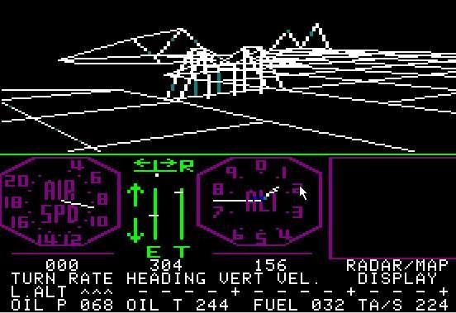
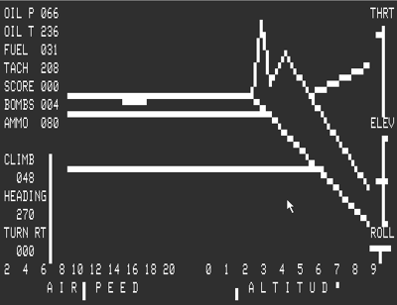
Traditional Virtual Reality
Sensorama had others thinking
Lead to advanced technology
Virtual reality of today
Designed in 1966 by Thomas Furness III
Flight simulator
Airforce training
vf-air.com, n.d.
vf-air.com, n.d.

Slide 10
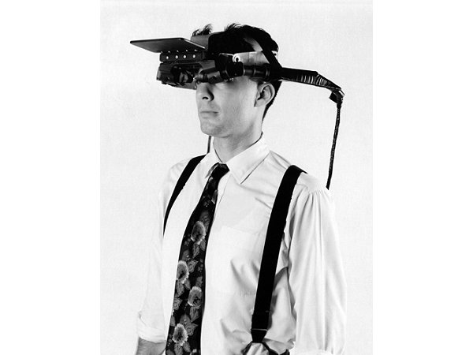
Where It’s Gone
Head-mounted Displays (HMD)
Used to enhance experience
Invented by Ivan Sutherland
Student assisted in creation
Created in 1968
Widely considered first HMD
Ivan Sutherland wearing his HMD
Computer History Museum, 1967

Slide 11
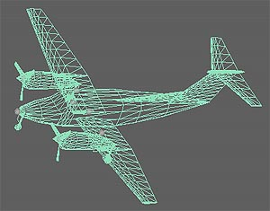
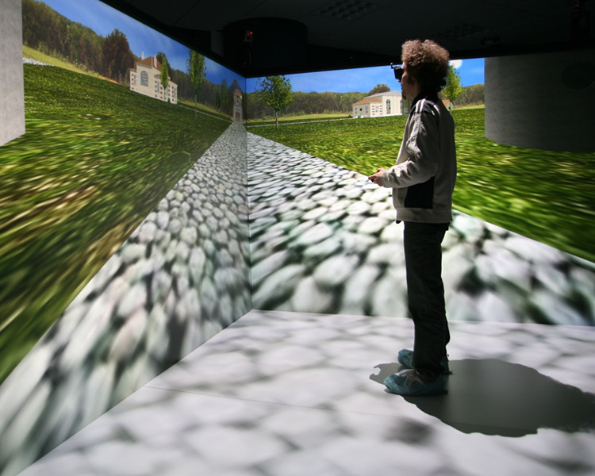
How It’s Evolved
Started as wireframes and basic shapes
Eventually utilized images and video
Going even further
Full 3D immersion
Augmented reality
Realistic user experience
Fidelity Flight Simulation Inc. n.d.
Antycip Simulation, n.d.

Slide 12
Science and Technology

Slide 13
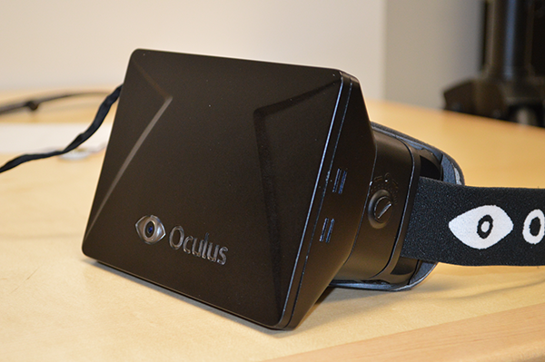
Head-mounted Displays
Display types
Fiber-optic
Virtual retinal
Plasma
Light emitting diode (LED)
Audio
Headphones
Speakers
Orland, 2012

Slide 14
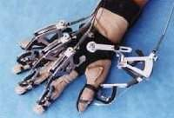
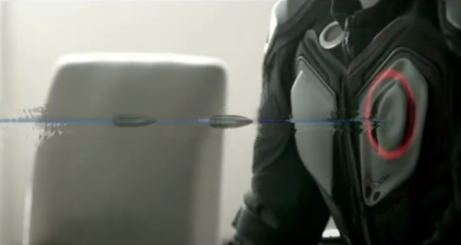
Human-machine Interface (HMI)
Gloves
Bodysuits
Bley, 1999
Virtual Reality Technology , n.d.

Slide 15
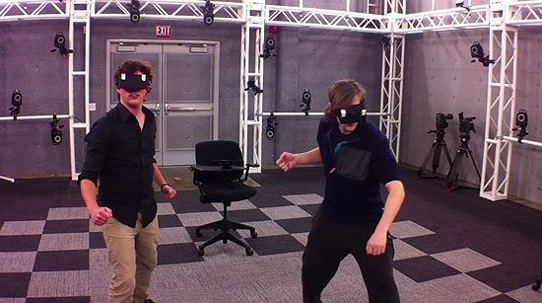
Tracking Systems
Head tracking
Position tracking
Wong, 2012

Slide 16
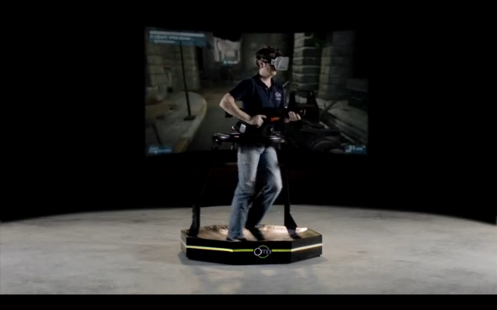
Systems
Oculus Rift
Head tracking
LED display
Other technologies
Omnidirectional treadmill
Haptic suit
Gun controllers
Wong, 2013

Slide 17
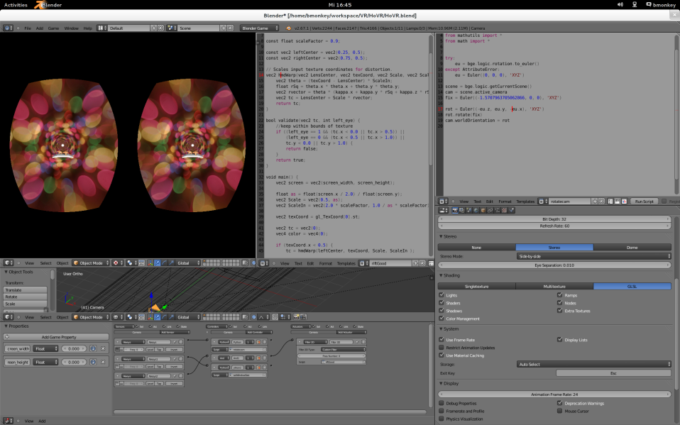
Systems (cont.)
Development
Software development kit (SDK) in development
Existing SDKs adding Oculus Rift functionality
Unreal Engine
Unity Engine
Blender Engine
Oculus, 2013

Slide 18
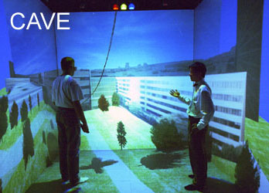
Systems (cont.)
CAVE
Head tracking
Position tracking
Other technologies
Head-mounted display
HMI gloves
Forget, 2012

Slide 19
Art and Education

Slide 21
Business

Slide 22
Cost Savings
Cost to build virtual reality lab: $2,000,000
Cost to use lab for the day: $1,000

Slide 23
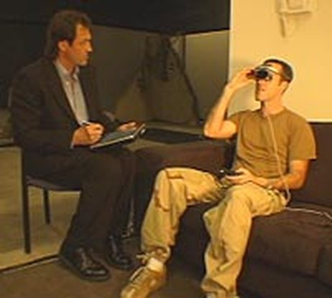
Cost Savings (cont.)
Navy saves nearly $115,000 for every 12 patients treated using Virtual Reality
Jardin, 2005

Slide 24
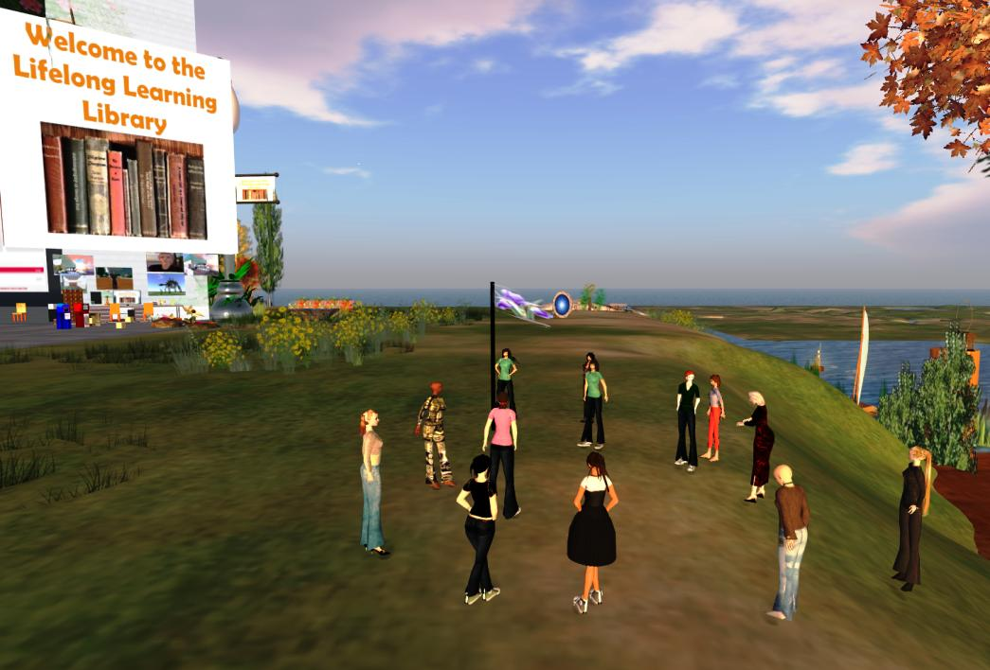
Cost Savings (cont.)
“The cost of a virtual event compared with a physical one is close to 90 per cent less”(Southan, 2011)
Hill, 2013

Slide 25
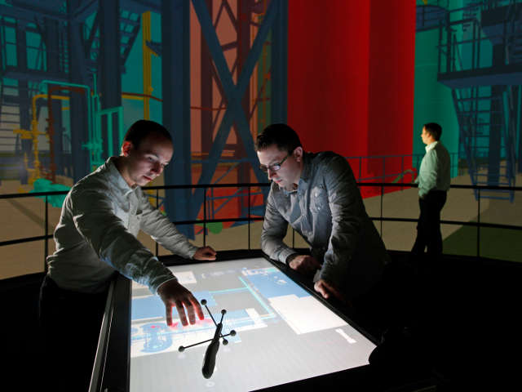
Potential Increased Profits
Better training from virtual reality
Testing for oil
Beciri, 2012

Slide 26
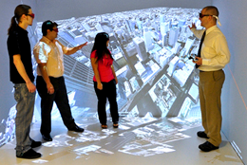
Cost of Systems
CAVE : $500,000
Oculus projected under $300
The University of Alabama in Huntsville, 2013

Slide 27
Psychology

Slide 28
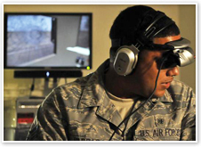
Treatment and Therapy
Posttraumatic Stress Disorder (PTSD)
Training
Desensitization
Parkinson’s
Virtual reality aids, n.d.

Slide 29
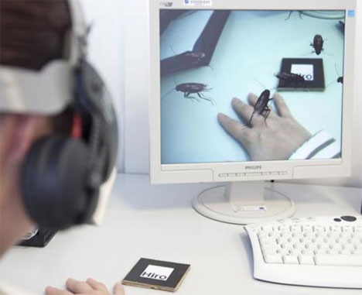
Treatment and Therapy (cont.)
Strokes
Phobias
Exposure therapy
Stress
Bugged , n.d.

Slide 30
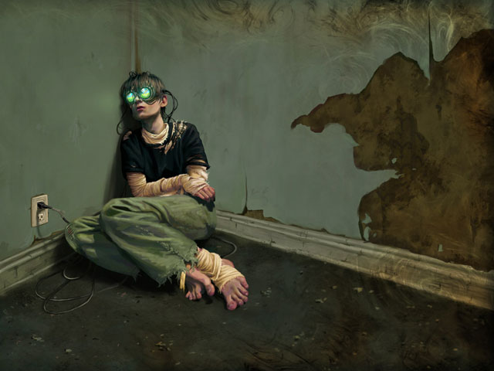
Ethics
Desensitization
Cyber addiction
Virtual criminality
A Dark View, 2006

Slide 31
Future

Slide 32
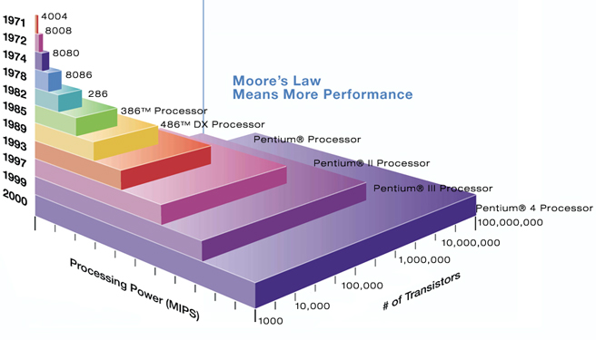
Moore’s Law
Technology doubles every two years
Processors
Technology will catch up
Vecchio, 2011

Slide 33
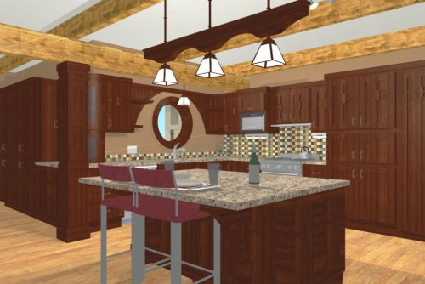
Future Applications – Architecture and Construction
Clients visit virtual buildings
Homes
Offices
Experience
Fragrances
Textures
Sounds
Avoid costly changes
Schmelzer, 2009

Slide 34
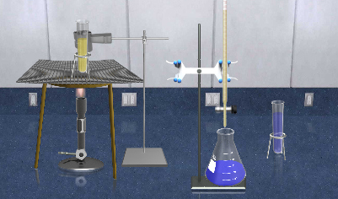
Future Applications – Education
Conduct science experiments safely
Study galaxies through travel
Interaction with fictional characters
Rivero, 2012

Slide 35
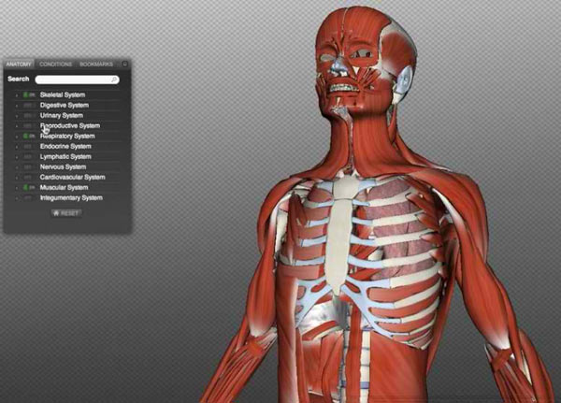
Future Applications – Medicine
Less dangerous
Virtual human body dissection
Procedural testing
Disease simulation
Darma, 2012

Slide 36
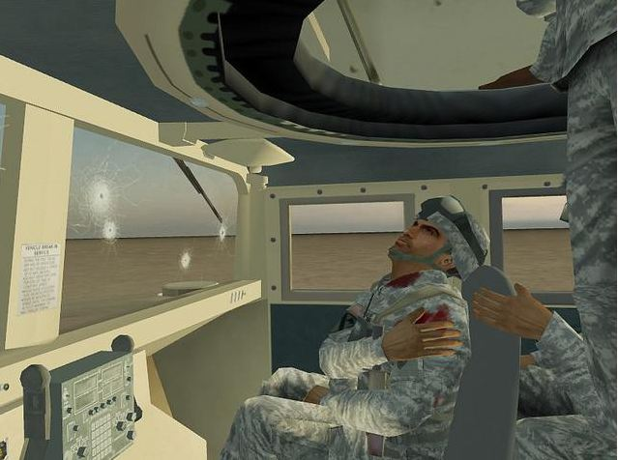
Future Application – Military
Simulation practice
War scenarios
Conflict resolution
Make decisions and see outcome
Military training, n.d.

Slide 37
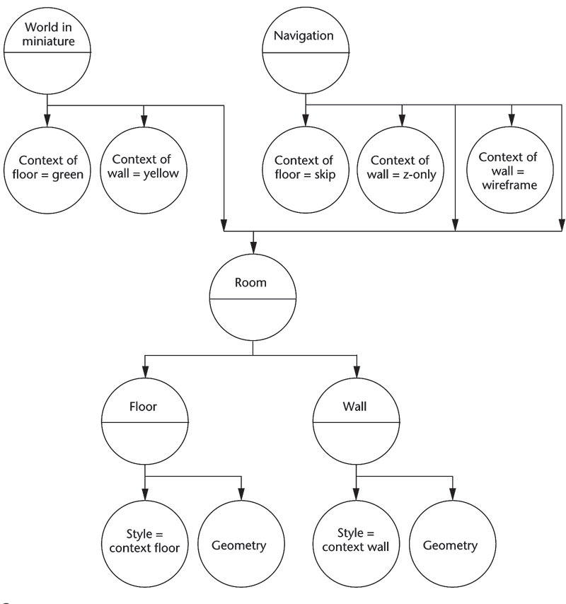
Artificial Life – Constraints
More natural world to user
High frame rates – realism
Scene graph traversal is slow
Polygon count must decrease
Virtual environment toolkits incapable of real physics
Schmalstieg, et al., 2007

Slide 38
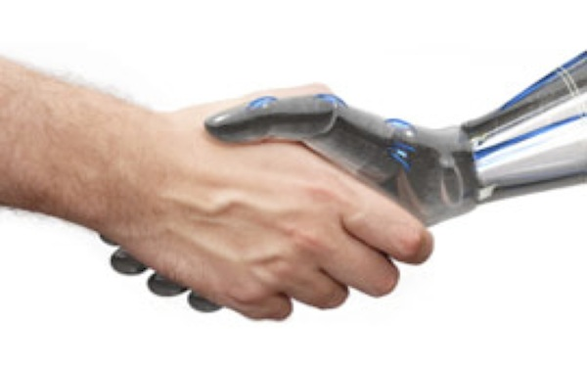
Artificial Life – Autonomous Agents
Perform dynamic roles
Envision human everyday life
React to the environment
Virtual sensors to learn from actions
Atkinson, et al., n.d.

Slide 39

Human Mind Uploading – Human Continuation
Cyborgs will be a reality
Replace brain location with machine
Problems
Eternal life
No needs
Emotionless unless programmed
Posel, 2012

Slide 40

Human Mind Uploading – Live in the Virtual World
Live virtually
Scan mind, upload, 3D model
Ageless
Limitations
Developer dictated
Physics
Life/death
Niiler, 2013

Slide 41
Conclusion
Virtual reality brings forth many new possibilities that were never available before, especially in major fields that require simulated environments.

Slide 42
History and Evolution References
Antycip Simulation (n.d.). Virtual Reality Solutions. Antycip. Retrieved from http://www.antycipsimulation.com/solutions/virtual-reality-solutions
Computer History Museum (1967). Ivan Sutherland wearing early head-mounted display. Computer History. Retrieved from http://www.computerhistory.org/revolution/input-output/14/356/1888
Ferragallo, R. (n.d.). Sensorama. Virtual Reality. Retrieved from http://www.ferragallo.com/sensorama.html
Fidelity Flight Simulation Inc. (n.d.). Superior Aerodynamic Modeling Capability. Fidelity. Retrieved from http://www.fidelityflight.com/aero-model.htm
International Arcade Museum (n.d.). Battlezone. Killer List of Video Games. Retrieved from http://www.arcade-museum.com/game_detail.php?game_id=7059
Timerime (n.d.). Timeline. Morton Heilig. Retrieved from http://www.timerime.com/en/event/847900/Morton+Heilig/
Virtual Flight(n.d.). History of Virtual Flight. Virtual Flight Air. Retrieved from http://www.vf-air.com/FS6.htm

Slide 43
Science and Technology References
Bley, F. (1999). Virtual Reality Technology. Fbley. Retrieved from http://www.fbley.de/index.htm
Forget the Red Pill. (March 26, 2012). Could this happen. Retrieved from http://couldthishappen.com/?p=373
Oculus Rift Support In Blender Game Engine. (June 26, 2013). Lubosz's Blog. Retrieved from http://lubosz.wordpress.com/2013/06/26/oculus-rift-support-in-blender-game-engine/
Orland, K. (November 28, 2012). Oculus delays dev kits for Rift head-mounted display by three months. Arstechnica. Retrieved from http://arstechnica.com/gaming/2012/11/oculus-delays-dev-kits-for-rift-head-mounted-display-by-three-months/
Virtual Reality Technology 4: ARAIG Gaming Feedback Suit. (n.d.). TangledTech. Retrieved from http://tangledtech.com/gaming/virtual-reality-technology-4-araig-gaming-feedback-suit
Wong, R. (July 23, 2012). Homemade holodeck inches gaming closer to virtual reality. DVICE. Retrieved from http://www.dvice.com/archives/2012/07/homemade_holode.php
Wong, R. (August 12, 2013). Insane Virtuix Omni VR treadmill can now be preordered for $500. DVICE. Retrieved from http://www.dvice.com/2013-8-12/insane-virtuix-omni-vr-treadmill-can-now-be-preordered-500

Slide 44
Art and Education References

Slide 45
Business References
Beciri, D. (2012, July 3). Virtual Development and Training-Platform for production facilities. Robaid. Retrieved from http://www.robaid.com/tech/virtual-development-and-training-platform-for-production-facilities.htm
Hill, V. (2013). 3D Sci-Fi Library Exhibit in Inworldz. Valibrarian. Retrieved from http://vhill.edublogs.org/category/virtual-reality/
Jardin, X. (2005, Aug. 19). Virtual Reality Therapy for Combat Stress. National Public Radio. Retrieved from http://www.npr.org/templates/story/story.php?storyId=4806921
Southan, J. (2011). Meet Me in Cyberspace. Business Traveller (UK/Europe Edition), 40-43.
University of Alabama in Huntsville. (2013). Welcome to UAHuntsville’s CAVE. Retrieved from http://www.uah.edu/news/research/5242-welcome-to-uahuntsville-s-cave#.Ugv5mJKTiSp

Slide 46
Psychology References
A Dark View Into the Future of Game Addiction. (November 2, 2006). MAVAV. Retrieved from http://www.mavav.org/2006/11/02/a_dark_view_into_the_future_of_game_addiction.php
Bugged Out: Augmented Reality Insects Help Beat Phobia. (n.d.). Gajitz. Retrieved from http://gajitz.com/bugged-out-augmented-reality-insects-help-beat-phobia/
Virtual reality aids PTSD treatment. (n.d.). health.mil. Retrieved from http://www.health.mil/MHSCIO/news_resources/portal/june2010/ptsd.aspx

Slide 47
Future References
Atkinson, D., Clark, M., & Venable, B. Autonomous agents lab. (n.d.). Florida Institute for Human & Machine Cognition. Retrieved from http://www.ihmc.us/groups/datkinson/wiki/107cd/
Darma, S. (2012, January 13). Medical students to wear 3D glasses for anatomy class? MedGadget. Retrieved from http://www.medgadget.com/2012/01/medical-students-to-wear-3d-glasses-for-anatomy-class.html
Military training and military readiness: Are you ready for combat challenges? (n.d.). Military Grade Nutritionals. Retrieved from http://militarygradenutritionals.com/blog/military-training/military-training-and-military-readiness-are-you-ready-for-combat-challenges/
Niiler, E. (2013, May 17). When will the human mind upload to a computer? Signs of the Times. Retrieved from http://www.sott.net/article/261922-When-will-the-human-mind-upload-to-a-computer
Posel, S. (2012, December 13). Transhumanism: How the elite plan to live forever. Occupy Coporatism. Retrieved from http://www.occupycorporatism.com/transhumanism-how-the-elite-plan-to-live-forever/
Rivero, V. (2012, January 12). Interview | Staying up with LateNiteLabs. Ed Tech Digest. Retrieved from http://edtechdigest.wordpress.com/2012/01/12/interview-staying-up-with-latenitelabs/
Schalstieg, D., Schall, G., Wagner, D., Barakonyi, I., Reitmayr, G., Newman, J., & Ledermann, F. (2007, July). Managing complex augmented reality models. IEEE Computer Society. Retrieved from http://www.computer.org/csdl/mags/cg/2007/04/mcg2007040048-abs.html
Schmelzer, P. (2009, February 19). Virtual model homes. Vivus Architecture. Retrieved from http://vivusarchitecture.com/archive/virtual-model-homes
Vecchio, P. D. (2011, May 6). De-mystifying software performance optimization. Intel. Retrieved from http://software.intel.com/en-us/articles/de-mystifying-software-performance-optimization

